Slide 1

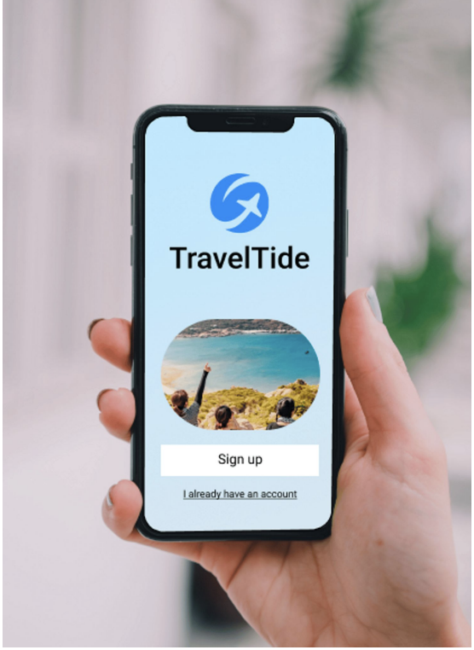

TravelTide Customer Segmentation & Rewards Program
Presented by : Leela Yathapu
Welcome to our comprehensive analysis of TravelTide e-booking startup. Customer feedback has shown, and industry analysts agree, TravelTide customers have access to the largest travel inventory in the e-booking space.

Slide 2
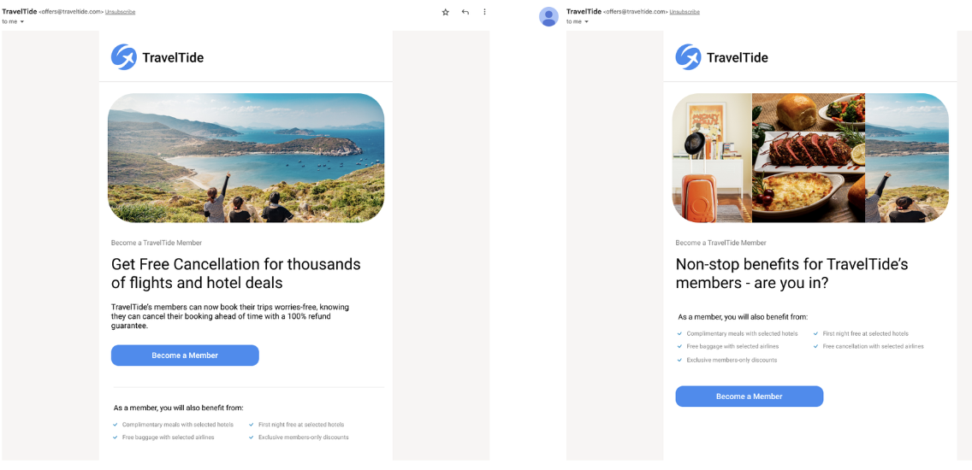
Project Objective & Reward Program
Objective
Design and execute a fantastic personalized rewards program that keeps customers returning to the TravelTide platform. - To do so we need to segment customers based on their travel behavior.
Reward Program
To send customized emails we will try to differentiate our customers based on potential interest in our program:
- Free Hotel Meal
- Free Checked Bag
- No Cancelation Fee
- 1 Night Free with Flight
- Exclusive Discount
Notes:
Our Project objectives are threefold: to analyse the sales data, identify strengths and weaknesses in business operations, and highlight opportunity for growth and profitability.

Slide 3

Approach
Exploring the Data
User Segmentation
Analysis and finding
Recommendation
To achieve these objectives, we conducted an in-depth analysis of TravelTide's customer data, considering various customer behaviours and attributes to identify potential affinities to specific perks.
The process involves filtering TravelTide data according to specific cohort definitions, aggregating Session, Flight, and Hotel data while preserving key demographic and behavioural fields, and merging these insights into a comprehensive dataset.
Key features considered for segmentation and perk assignments are Discount Responsiveness, Booking Rate , Cancellation Rates, Average Total Spent by Users on flights and hotels.
Notes:
Our Project objectives are threefold: to analyse the sales data, identify strengths and weaknesses in business operations, and highlight opportunity for growth and profitability.

Slide 4
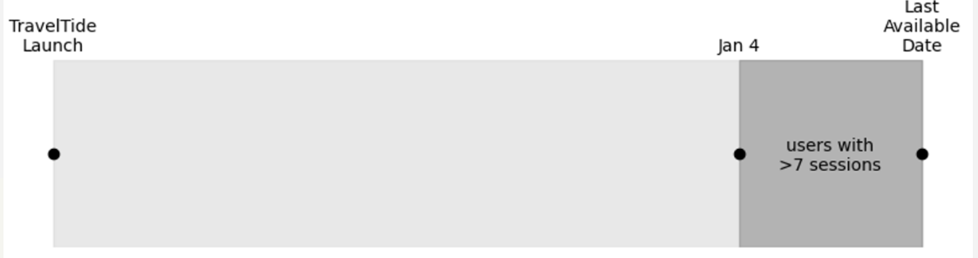
Data Observation and Cohort Filtering
Travel Tide currently consists of around 1.6m users.
Suggested by Elena, we include users with more than 7 sessions since Jan 4, 2023.This led to 5998 eligible users.
Out of a total of 5,998 users, we found that booked a total of 16,702 trips, with an average of 3 trips per user.
The majority of our users fall into the middle-aged bracket (b/w 36 and 55 years)
A total of 95% of booking are done by women.
55% users are unmarried & 67% users dont have children
All our customers originate from either the USA or Canada
Notes:
Our Project objectives are threefold: to analyse the sales data, identify strengths and weaknesses in business operations, and highlight opportunity for growth and profitability.

Slide 5
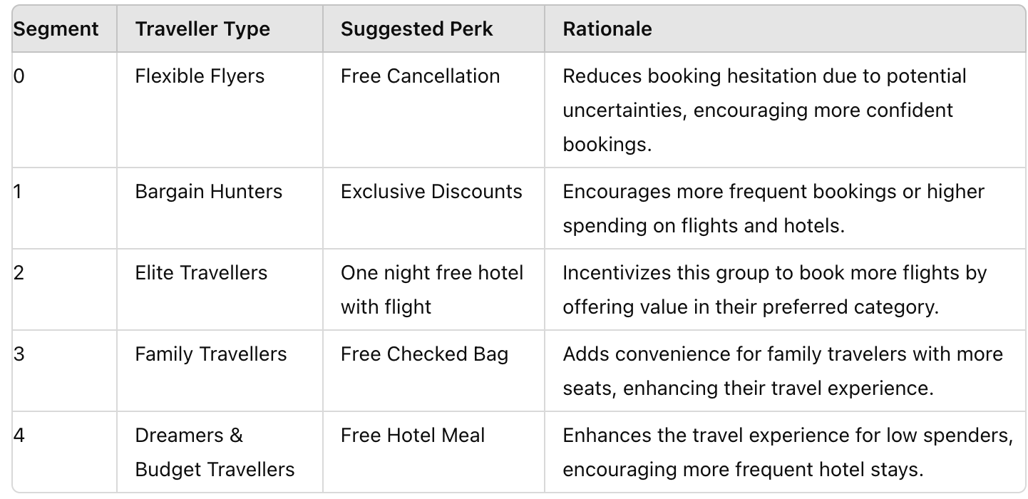
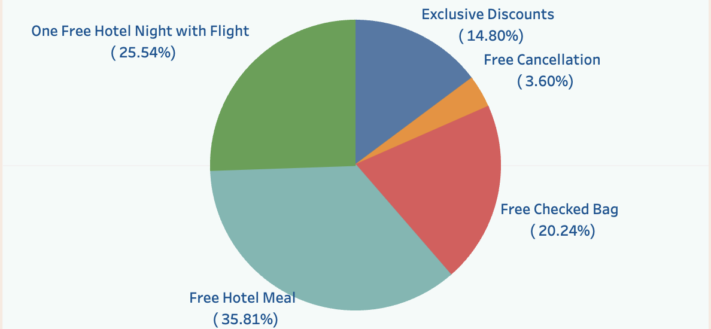
Perk Distribution among Customers
Notes:
Our Project objectives are threefold: to analyse the sales data, identify strengths and weaknesses in business operations, and highlight opportunity for growth and profitability.

Slide 6


Key Considerations For Perk Distribution
Flexible Flyers: Free Cancellation Perk (3.6% Customers)
Mean Cancellation Rate: 0.67– Extremely high cancellation rate.
Mean KM Flown: 8803.38 – Significant travel distance.
Given the extremely high cancellation rate and frequent long-distance travel, this segment values flexibility. Offering free cancellation would directly address their high cancellation tendencies and reduce booking hesitancy.
Bargain Hunters: Exclusive Discounts Perk (14.8% Customers)
Mean Flight Discount Amount: 0.28,Mean Hotel Discount Amount: 0.16 – High flight and hotel discounts. High responsiveness to discounts.
This segment is fairly balanced in spending across flights and hotels, with a moderate booking rate. Offering exclusive discounts can further incentivize bookings, especially since they already respond to discounts. They are price-conscious but don’t require flexibility like free cancellation.
Notes:
Our Project objectives are threefold: to analyse the sales data, identify strengths and weaknesses in business operations, and highlight opportunity for growth and profitability.

Slide 7
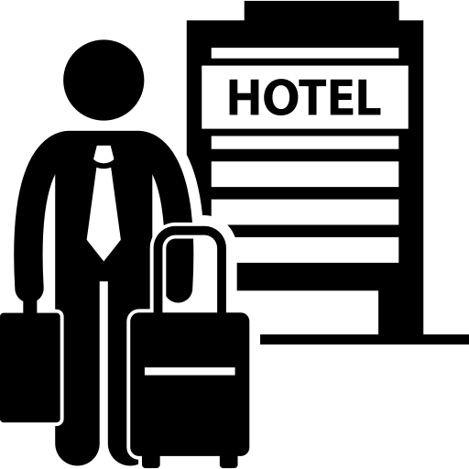

Key Considerations For Perk Distribution
Elite Travellers: Free Hotel Night With Flight (25.54% Customers)
Mean Booking Rate: 0.45 – High booking rate.
Mean Flights + Hotels: 2.70 – High combination of flights and hotels.
Mean Total Dollars Spent: 4202.35 High Overall Spending
Given their significant hotel expenditure and low cancellation rate, offering "One Free Hotel Night with Flight" would be highly attractive and would entice them to also book flights through the platform, increasing their engagement and possibly cross-selling flight services., enhancing overall engagement and satisfaction.
Family Travellers: Free Checked Bag (20.24% Customers)
Mean Booking Rate: 0.46 – High booking rate.
Mean Avg. Bag Checked: 1.67 – Frequently checks bags.
Mean Trips: 3.76- High number of trips, more flight-oriented.
As the largest and most active segment with frequent flights, offering a free checked bag can enhance their travel experience, encouraging continued loyalty and potentially increasing flight bookings.
Notes:
Our Project objectives are threefold: to analyse the sales data, identify strengths and weaknesses in business operations, and highlight opportunity for growth and profitability.

Slide 8
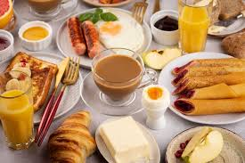
Key Considerations For Perk Distribution
Dreamers & Budget Travellers: Free Hotel Meal (35.81% Customers)
Mean Booking Rate: 0.25 – Moderate booking rate.
Mean Flights + Hotels: 1.89 – Moderate combination of flights and hotels.
Mean Total Dollars Spent 1051.54- Low overall spending
About 9% of customers who are active but not booked yet with Traveltide.
This segment spends less and books less frequently. Given their balanced travel behavior offering a free hotel meal would add value to their bookings, encouraging them to engage more without requiring them to spend a large amount. Thereby current dreamers could be our future potential customers.
Benefits
In summary, the perks have been assigned based on each group's specific travel behaviours, spending patterns, and potential needs for flexibility or additional benefits.
Directly addresses current customer behaviours and preferences.
Enhances customer satisfaction by offering relevant perks and loyalty within each segment.
Encourages continued engagement based on existing usage patterns.
Notes:
Our Project objectives are threefold: to analyse the sales data, identify strengths and weaknesses in business operations, and highlight opportunity for growth and profitability.

Slide 9
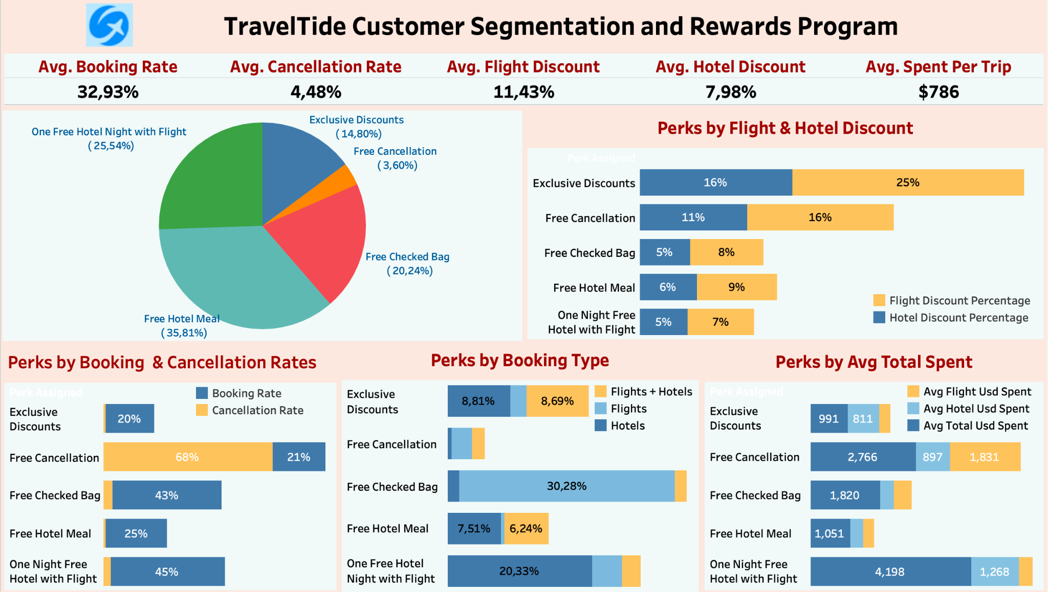
Key Insights at a Glance
Notes:
Our Project objectives are threefold: to analyse the sales data, identify strengths and weaknesses in business operations, and highlight opportunity for growth and profitability.

Slide 10
Recommendations
Focus on users who book multiple trips, particularly those who have already booked both flights and hotels together for their second or third trip. Create exclusive discount offers tailored to this segment, enticing them to continue booking all-inclusive travel packages.
Since users who book flight and hotel packages tend to spend more, ensure the booking process for combined packages is seamless and user-friendly. Highlight the potential savings and convenience of booking together.
Consider expanding the availability of discounts to a broader audience. While only 29% of trips received discounts in our analysis, there may be opportunities to attract more users by offering discounts for their first trips as well.
These recommendations should help tailor marketing strategies and email invitations to maximize customer engagement with TravelTide's rewards program.

Slide 11
Next Steps & Conclusion
Next Steps
Segmented Email Campaigns
A/B Testing for Optimization
Monitoring User Engagement
Feedback Collection
Contineous Refinement
Conclusion
By following this structured approach, we aim to not only attract customers but also maintain their engagement and loyalty by offering perks that align with their preferences. The continuous refinement of our offerings and strategies is pivotal to our long-term success.
It's essential to note that user preferences may evolve over time. Therefore, we recommend regularly reviewing of analysis to adapt to changing user behavior and market dynamics.

Slide 12

Project Links
Project Links: Project-Deliverables Colab Spreadsheet Tableau
Presentation TravelTide ERD Github
Thank You!
Any questions?
Notes:
"Lastly, I'd like to acknowledge our project team: Akilan, Leela, Rama, Tsai, and Vani, for their dedication and hard work in this comprehensive analysis."

